Slide 1
Use Case

Slide 2
Types of Use Cases
High Level Use Case (Brief)
Name, Actors, Purpose, Overview
Expanded Use Case (Fully Dressed)
Add System Events and System Responses
Essential Use Case (Black Box)
Leave out technological implications
Ex. The system records the sale. (no mention of database etc.)
Concrete Use Case (White Box)
Specify technology

Slide 3
Expanded Essential Use Cases (Fully Dressed Use Cases)
Types of Use Cases
Purpose:
to allow the system designer and client to visualize the flow of actor actions and system responses. From this the client will understand how users will use the system, and the designer will be able to write pseudocode for each function. In addition, it is possible to use this document to anticipate opportunities for user error, which must be accounted for in the final system.
Definitions:
What it is: an analysis document which describes in detail the elements of functions identified in a High Level Use Case.
What is is not: Expanded Essential Use Cases are not graphical drawings. They do not include stick figures, boxes representing the system, or any other icons found in a High Level Use Case although they may be associated with one.

Slide 4
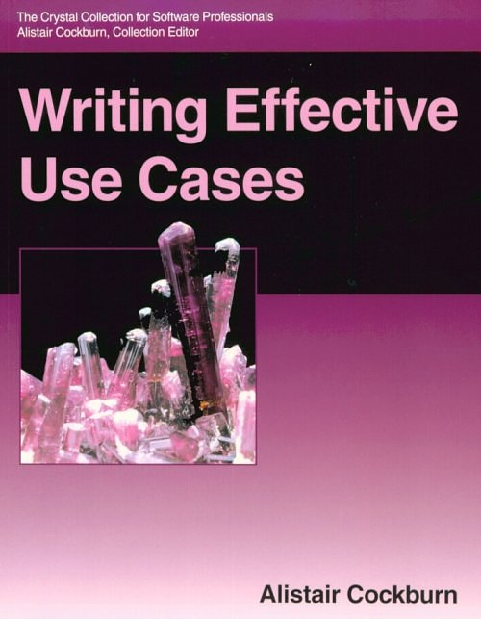
Use Case Template
Name
Primary Actor
Scope
Level: user-goal or subfunction
Stakeholders and Interests
Preconditions
Success Guarantee
Main Success Scenario
Extensions
Special Requirements
Technology and Data Variations List
Frequency of Occurrence
Miscellaneous (such as open items)
Preface
This is the basic format used in the text and in Alistair Cockburn’s Writing Effective Use Cases (Addison Wesley, 2000, ISBN 0201702258).
See also www.usecases.org
Optional
items

Slide 5
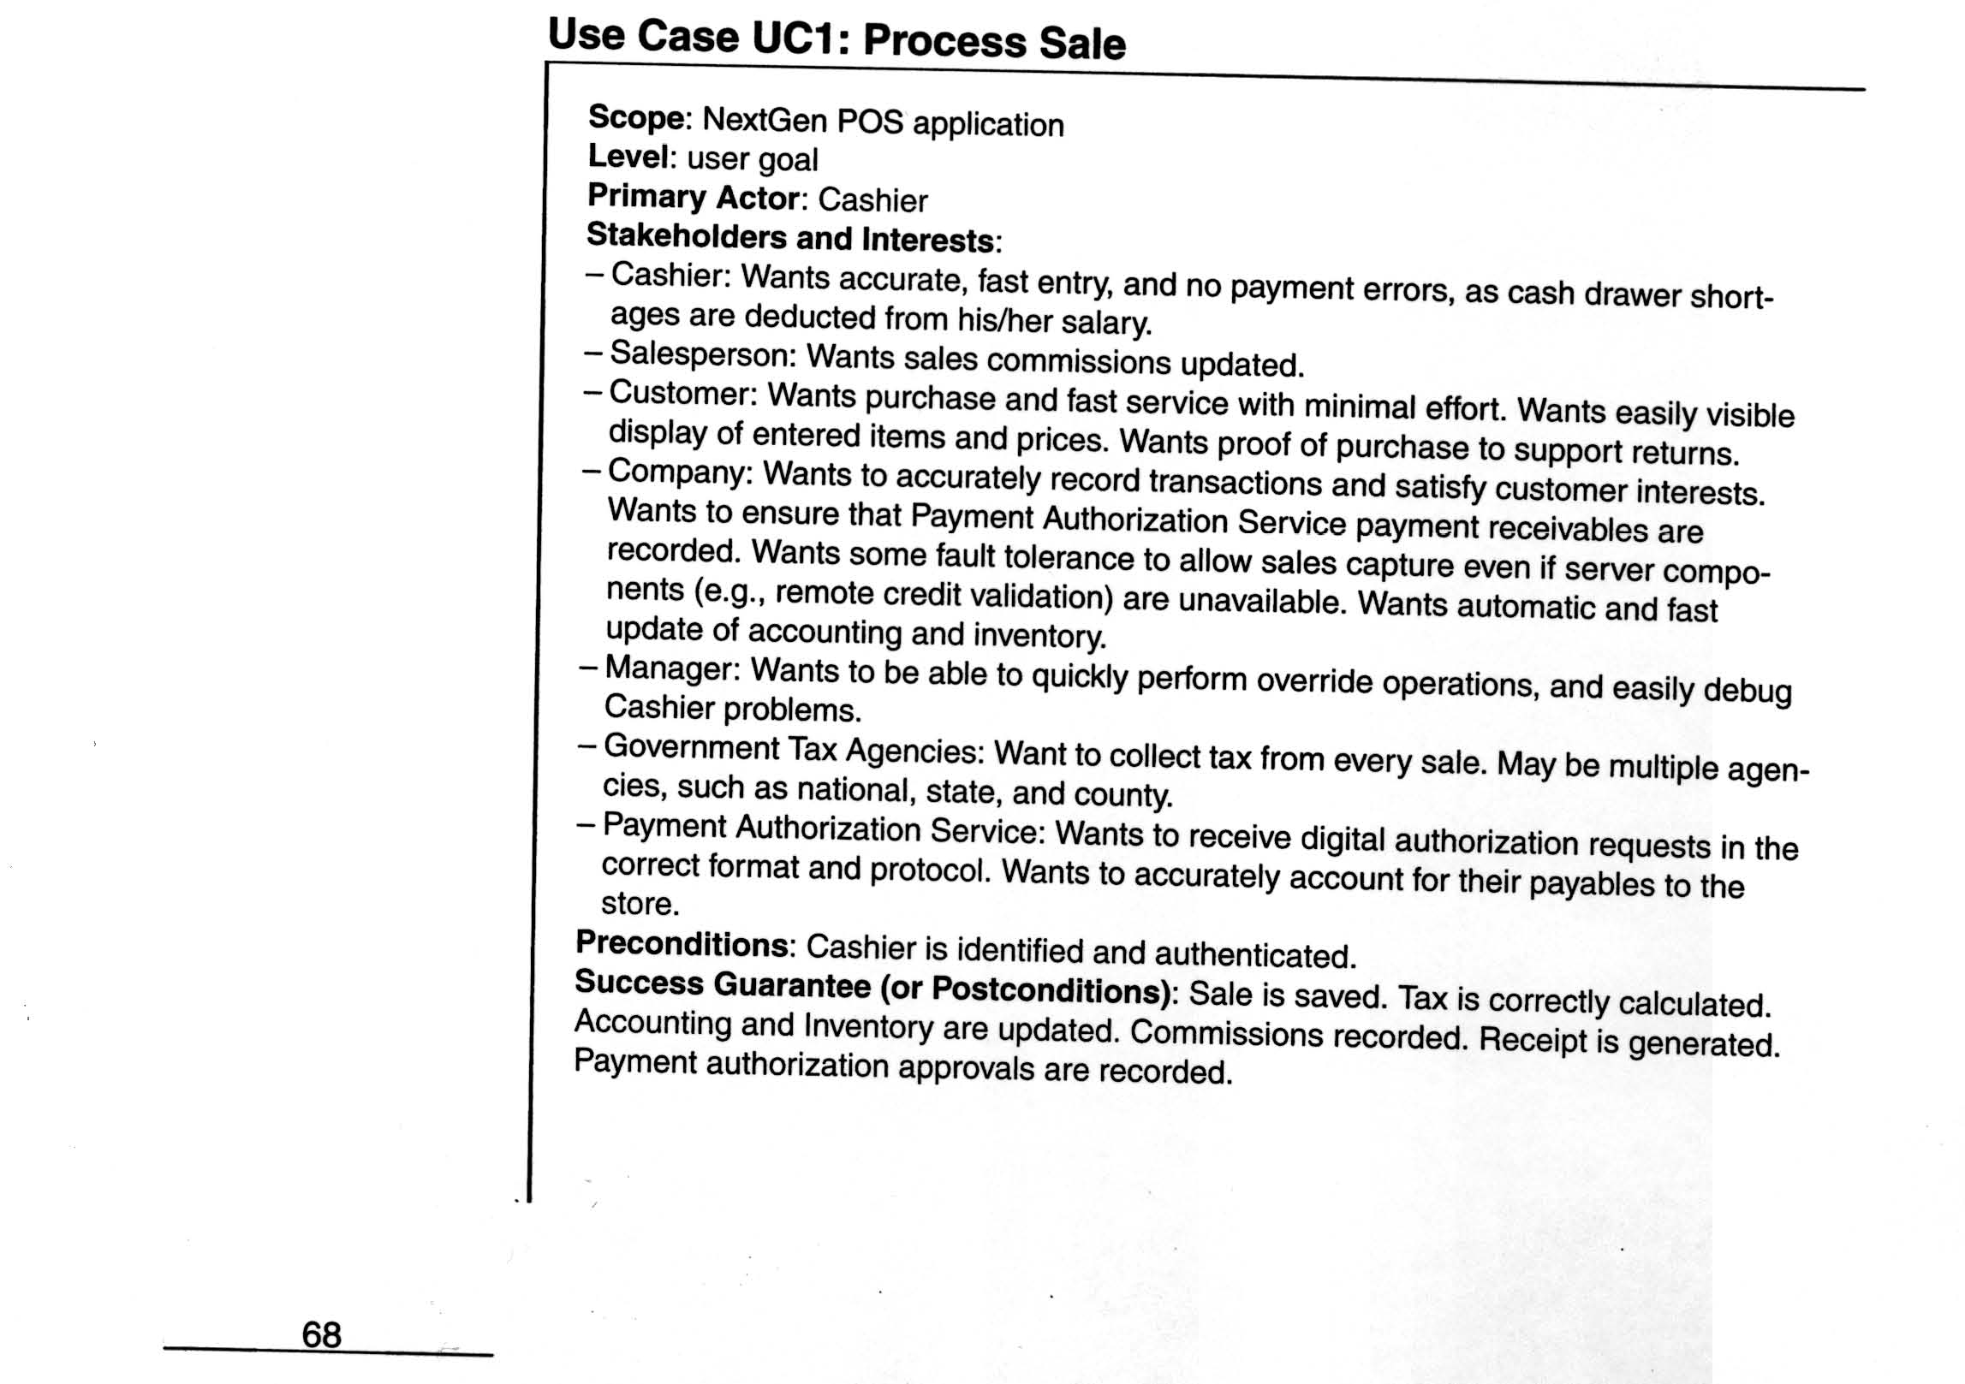
User-goal level
A complete process from the
view point of a user
to meet a goal of the user, roughly
corresponding to
an elementary business process.
Sub function level
Details steps to support
a user goal.

Slide 6
Define Actors
Actors should not be analyzed or described in detail unless the application domain demands it.
Template for definition:
Name
Definition
Example for an ATM application:
Customer: Owner of an account who manages account by depositing and withdrawing funds

Slide 7
Preconditions and Postconditions
Preconditions are anything that must always be true before beginning a scenario is a precondition.
Preconditions are assumed to be true, not tested within the Use Case itself.
Ignore obvious preconditions such as the power being turned on. Only document items necessary to understand the Use Case.
Success Guarantees (or Postconditions) state what must be true if the Use Case is completed successfully. This may include the main success scenario and some alternative paths.
For example, if the happy path is a cash sale, a credit sale might also be regarded a success.
Stakeholders should agree on the guarantee.

Slide 8
Scenarios
The Main Success Scenario, or “happy path” is the expected primary use of the system, without problems or exceptions.
Alternative Scenarios or Extensions are used to document other common paths through the system and error handling or exceptions.

Slide 9
Extensions (Alternative Flows)
Extensions or Alternative Flow Use Cases allow the specification of
Different ways of handling transactions
Error processes
Sections are convenient way to handle alternative courses of action
Sections are a segment of a use case executed out of sequence

Slide 10
Two Parts for Extensions
Condition
Describe the reason for the alternative flow as a condition that the user can detect
Handling
Describe the flow of processing in the same manner as the happy path, using a numbering system consistent with the original section.
3A. Condition: If [actor] performs [action] the system …

Slide 11
Documenting Extensions
Use same format as Happy Path
Document actions that vary from ideal path
Include error conditions
Number each alternate, and start with the condition:
3A. Condition: If [actor] performs [action] the system …
If subsequent steps are the same as the happy path, identify and label as (same)
Steps not included in alternate course are assumed not to be performed.

Slide 12
Special Requirements
If a non-functional requirement , quality attribute, or constraint affects a use case directly, describe it as a special requirement.

Slide 13
Technology and Data Variations List
Often there are technical differences in how things are done even though what is done is the same. These things can be described in the Technology and Data Variations List.
For example, if a card reader cannot read the magnetic stripe on a credit card, the cashier might be able to enter it on the keyboard.

Slide 14
Technology
Types of Use Cases
The distinction between an essential (black box) use case that leaves out technology and a real (white box) use case that includes technology is fundamental.
For example, in an Automated Teller Machine, an essential use case can mention identification or validation, but only a real use case can mention a key pad or card reader.

Slide 15
Expanded Essential Use Cases (Fully Dressed Use Cases)
Types of Use Cases
Purpose:
to allow the system designer and client to visualize the flow of actor actions and system responses. From this the client will understand how users will use the system, and the designer will be able to write pseudocode for each function. In addition, it is possible to use this document to anticipate opportunities for user error, which must be accounted for in the final system.
Definitions:
What it is: an analysis document which describes in detail the elements of functions identified in a High Level Use Case.
What is is not: Expanded Essential Use Cases are not graphical drawings. They do not include stick figures, boxes representing the system, or any other icons found in a High Level Use Case although they may be associated with one.

Slide 16
Use Case #1 | Quiz Instant Feedback
Description | An educational technology company wants to develop a feature that allows students to take quizzes and receive instant feedback.
Actors | Students
Goals | Take a quiz, view quiz results
Stakeholders | Educational technology company, students, educators, school administration, investors
Pre-conditions | Student must be logged in, student must have access to the quiz
Post-conditions | Student can take the quiz and receive instant feedback on their performance
Basic flow | Student logs into the educational technology platform and selects the option to take a quizSystem presents the student with the quiz questionsStudent answers the questions and submits the quizSystem evaluates the student's answers and provides instant feedback on their performanceStudent views the feedback and can review their answers if they desireSystem records the quiz results and makes them available for the student, educator, and administration to view
Alternate path | Student logs into the educational technology platform and selects the option to view previous quiz resultsSystem presents the student with a list of previous quizzes they have taken, along with their resultsStudent selects a previous quiz to viewSystem displays the student's answers and the correct answers for each questionStudent reviews their answers and receives feedback on their performance

Slide 17
Create fully dressed use case from Restaurant Management system:
Submit a order
View the order

